Slide 1
How to Download ScratchJr Blocks and Bots

Slide 2
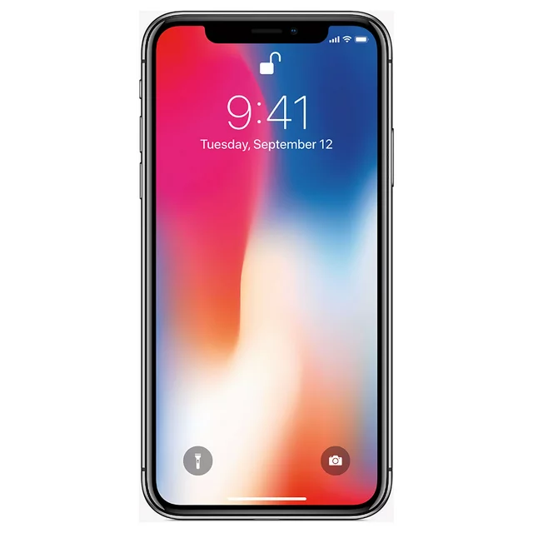
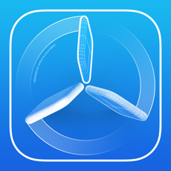
Steps 1-2
2.
Download “Testflight” on from the App store
No need to do anything with this app yet, just download it
You need an iPhone or iPad

Slide 3
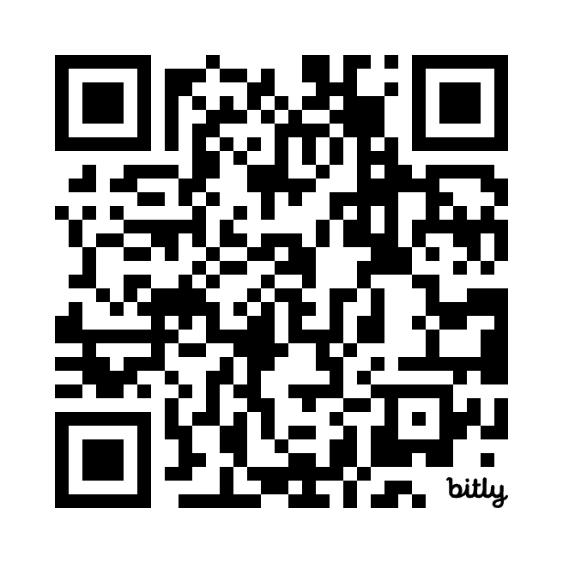
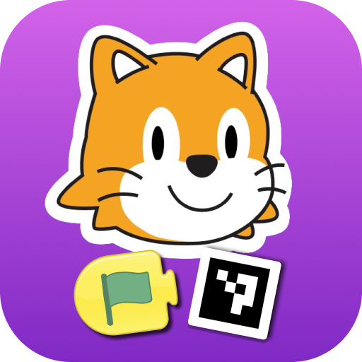
Step 3 - ScratchJrBlocks
With the camera of your device, scan this QR code
Notes:
BethRules

Slide 4
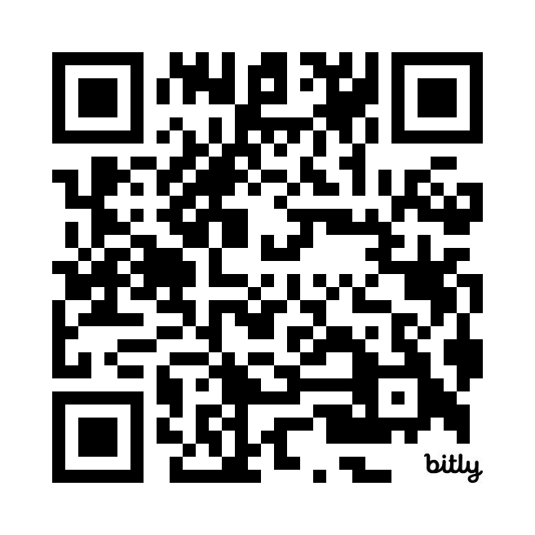
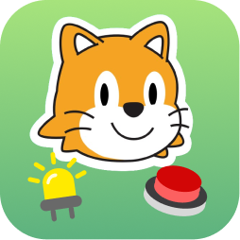
Step 3 - ScratchJrBots
With the camera of your device, scan this QR code
After opening link click “Continue to destination”
Notes:
BethRules

Slide 5
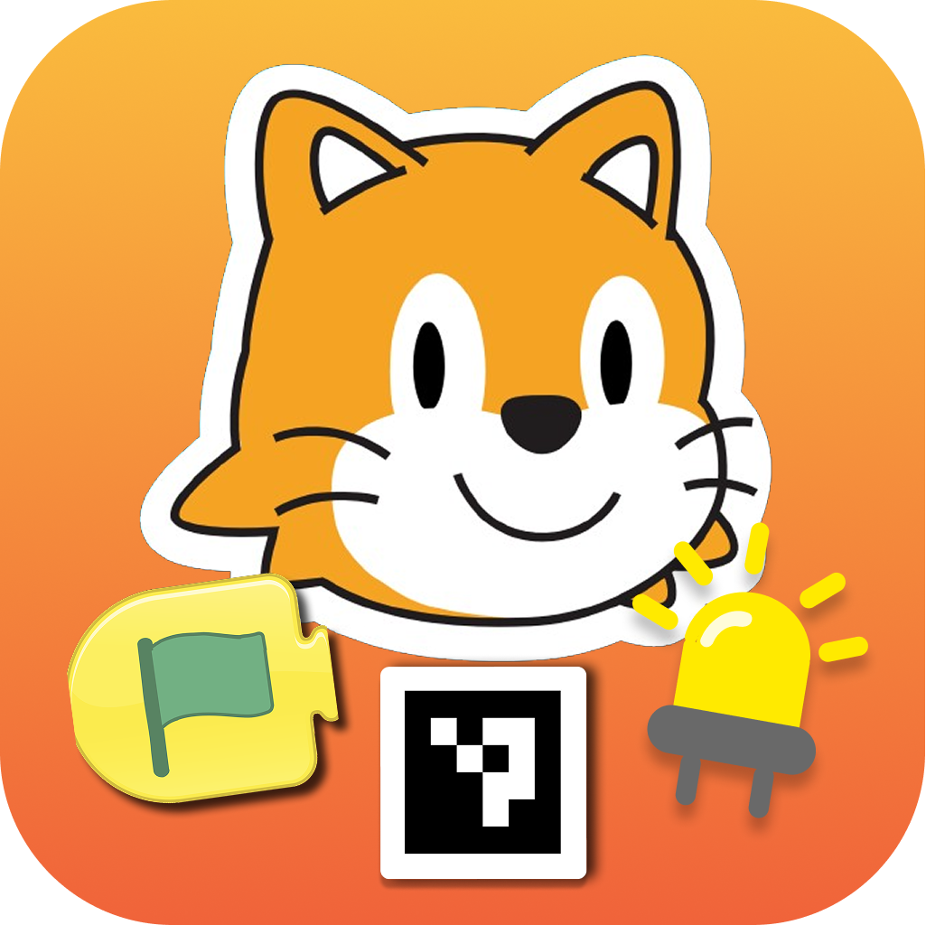
Step 4
Open Testflight again, and you should now see the Blocks and Bots apps!
If not, go back to browser and click
“view in TestFlight”
Notes:
BethRules

Slide 6
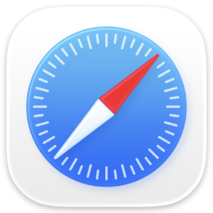

Step 5
Go back to internet browser
Click “view in TestFlight”
Notes:
BethRules

Slide 7
Step 6
Return to Home Screen
Click on apps
Notes:
BethRules

